Slide 1
Clearing Up
Misconceptions
About Our
Game Play
My intent here is to clear up some of the common misconceptions our fans might share that I’ve observed regarding the intent of our play or the style of our play.

Slide 2
“What are you doing?”
I hear this a lot after a player makes a pass that wasn’t very good.
There are three reasons why a player makes a bad pass or ‘shanks’ a shot at goal.
A mistake. Plain and simple. Soccer is a tough sport to play and making a ball do exactly what you want 100%
of the time is just not going to happen. Example, an outside defender attempts to pass a ball down the line, but
mistakenly hits it toward the center of the field to an opponent. That is not coached. That was not the players
intent. Thankfully, the players on our team don’t make a lot of these mistakes, but to think they make none of
them is unrealistic. Hopefully, we are ‘good’ enough to adjust and make sure the problem doesn’t cost us a goal
or the game.
Lack of poise under pressure. This usually shows up more frequently when we play more athletic teams.
When an opponent is putting high pressure on one of our players, it is very difficult to remain calm, see the field,
not give up the ball, AND make a good pass/shot. Sometimes players make a split second decision under pressure and things
don’t go perfectly. In practices, we run drills specifically to try and help players think quicker and more efficiently when
under pressure. But, again, to think every pass or decision under pressure will be wonderful is ludicrous. The goal of our
training is to limit mistakes under pressure AND to correct them before a ‘soccer crisis’ happens.
Miscommunication and speed of play. Consider a car accident. Are any of them done with intent or in the correct
state of mind? No. Someone thinks the car in front of them is going left when they are going right. The driver doesn’t
see another car when a decision is made. A driver is distracted by some other factor that is out of their control. Soccer
is pretty much the same way, but half of the other drivers are TRYING to cause an accident! One player thinks the other
will pass to the right, but the passer wants to pass to the left. The passer wants one player to come to the ball and the
receiver expects the pass to go long. This is one of the biggest areas we try to train in practice. Unfortunately, with 22
bodies flying around, each with their own ‘private’ decision-making brains, it’s no wonder that sometimes we read opponents
and even teammates incorrectly from time to time. We work on it and hope to limit it, but it WILL happen. Period.

Slide 3
“Why aren’t we going to a ball?!”
WE SHOULD:
For most games and with most opponents, we ARE supposed to challenge every ball. If we aren’t when we should, this IS a serious problem – i.e. the first Waynesville game of 2016-17. I can yell, sub players, bench players, halftime speech-it-up, etcetera, but for whatever reason, some girls on some days just don’t do it. This is certainly a reason to get upset with me and the team, but, trust me when I say, this comes up EVERY DAY in practice, before games, and at half time. It is without a doubt, the one thing I harp on the most. Go to your 50/50 balls.
SITUATION #1:
When opposing defenders are involved offensively. At most, when defending offensive defenders, we have 3 (usually 2) players trying to apply pressure. More often than not, most teams have 4 defenders. That is 3v4 or 2v4, meaning one or two opponents are always open. If we go rushing at a ball, they will EASILY pass around us and now we have to chase from behind. This means we will have 7 Shawnee players trying to defend 8 or 9 opponents. Consider also that helping defenders MUST then rotate out of position to try and help which exposes even more holes!
WE SHOULDN’T:
There are some occasions where I actually don’t want our players to step to the ball and each happens when our opponents are highly skilled or are a very good soccer team.

Slide 4
Figure 1.
Figure 1. If the ball gets passed to a midfielder, NOW we apply higher pressure, trying to force them backward again.
2
1
Overpursuing PS Girl!
Figure 2. If our forwards chase defenders who possess… they CANNOT cover more ground than a well passed ball. This will force our outside midfielder to step up to cover opponent #2 at which point the opposing teams midfielder (#3) is now without a marking defender! Now our outside defender must help our midfielder which will open up lots of space for the opponents attackers!! This will all happen simply because our forwards over pursued instead of simply “staying behind the ball”. So, do we really want to chase a ball with little to no hope of disrupting a play 75 yards away from our opponents goal, or would we rather just let fiddle with it in the back end and put the pressure on them to be perfect?
F
pass
M
pass
runner
D
Figure 1. If the ball goes from position 1 to position 2, notice the forward move backward at which point they can then apply forward pressure. We have 10 players “behind the ball” 6 or 7 attackers. I know it seems like that’s a LOT of defense, but consider what happens if we over-pursue.
pass
2
1
F
F
BREAKAWAY!
M
Figure 3. A simpler version leading to a breakaway.
3
D
Figure 2.

Slide 5
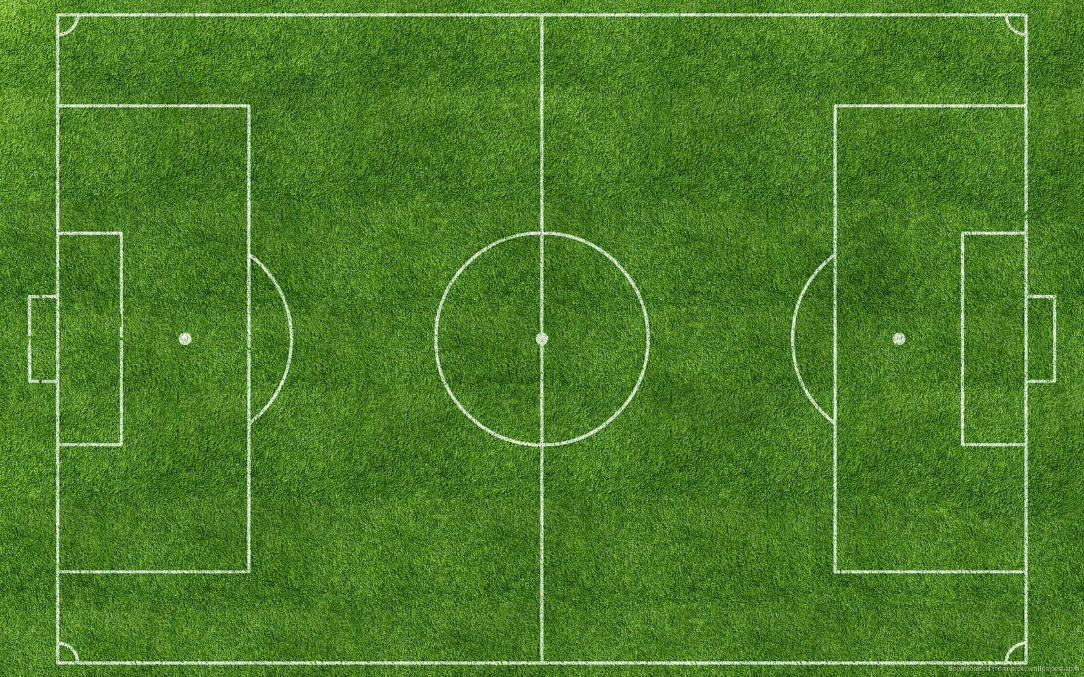
Scenario 2:
Transition! That is, a team counters one of our attacks very quickly and some of our players are caught too far forward (this IS part of the game and cannot really be “fixed”).
M
D
We just got done with an attempt at goal and our opponent comes rushing out of the back in attack…
M
F
D
M
M
D
F
BALL ends up here →
M
Right now, this situation is 5 vs 5. Not good but not too terrible. We do NOT want this player to ‘go to the ball’. In fact, we want her to back up and give the dribbler some space. If we commit and fail (a simple pass inside and back out would do it), the situation is now 5 v 4 AND it forces our last line of defense to spread out. Definitely NOT good. By backing up, we A)limit the ball handers options and B) give our teammates a chance to come back to help defend. Midfielders have to run a LOT and asking them to run 80 yard sprints downfield is just brutal especially after they obviously just made a run 40-50 yards in the other direction! Also, consider this… What threat does the player with the ball pose 70 yards out?

Slide 6
“We need more offense up there?
We need to play with more offensive players!
We need help up front!”
TRUTH:
Our style of play does not change from game to game. We do not play with more defenders and less offensive players nor do we change our approach, regardless of whether our opponents are the worst in state or the best in state. There are subtle changes based on our opponent of course, but, offensively, nothing changes. Period.
The appearance:
Admittedly, it does LOOK LIKE at times we are attacking with fewer players, but this is NEVER our intent. Do you recognize versus what kind of teams this appearance manifests? The really, really good ones.

Slide 7
The reason:
When playing “long”. This means we play long out of the back (the defenders “boom” it) or our midfielders get it and play immediately over the top of the opposing defenders. Is this an effective attack? Sometimes, yes, absolutely. If we have a forward(s) that simply out skills or out classes an opposing defender, I encourage playing long more frequently. But, again, in which games do we have that luxury? Usually the weaker opponents. REASON: Our midfielders run. A whole bunch. When we play a pass over the opposing defenders heads (aka “long”), that pass may be 30, 40, or 50 yards long. It is also quite often a 50/50 ball (meaning we aren’t 100% sure we WILL get it). Our forwards are about 20 yards in front of our midfielders with a ball that is played 20-40 yards beyond the forwards. Our forwards pursue (after NOT running up and down the field in 80 yard increments) and the gap between our mids and forwards grows from 20 to possibly 60 yards!! So… does it LOOK LIKE we are attacking with fewer players?? YES!! Because we are!
The solution:
Should we play long more often? Absolutely NOT. We may get a fortunate goal or two, but at what cost? Our midfielders would get gassed VERY quickly. Midfielders have the toughest job on the soccer planet. They must attack on one end and defend up to 120 yards away on the other! Not easy. So, when we play long, I encourage our mids to make their ‘runs’ wisely. They cannot run up and down the field for 80 minutes non-stop, even if we have ten midfielders ready to sub in for breathers. So, the SOLUTION: Make extra passes. Play slow-build-up so we can attack AT PACE with proper numbers. Delaying 4-5 seconds by holding/shielding a ball or by making a pass to another midfielder or BACKWARD to a defender is the answer! A simple 4-5 second delay gives our mids an extra 30 yards downfield AT A JOG!!! Whew. That’s nice!
Why do we attack more frequently with fewer numbers against the better teams then?
Simple. Better teams are MUCH harder to possess against than those teams that are not as good. So, the solution can only be reached IF we can continuously possess against everyone. Is that hard to do? 100%, unequivocally, yes. But, we are definitely working on that every day at practice. It is mentioned every day before games and at halftime.

Slide 8
If there are any questions, doubts, concerns about our style of play or what we are attempting to do or if you just want to understand the dynamics of the game a bit more, please feel free to contact me. I will be glad to answer/address any issues you may have! Or, I have faith that your daughter can also accurately answer almost any question you have, too! =)
Thanks for understanding and I hope this clears up some of the common misconceptions about our intent or purpose on the pitch.

